Slide 1
The Berkeley Initiative for Transparency in the Social Sciences
Fernando Hoces de la Guardia
CEGA , UC Berkeley
October 7th, 2019
Notes:
Total time: 10mins

Slide 2
Outline
Introduction
BITSS: Past
BITSS: Present
BITSS: Future

Slide 3
Outline
Introduction
BITSS: Past
BITSS: Present
BITSS: Future

Slide 4
What does it mean to do good science?
Scientific Norms (Merton, 1945):
Disinterestedness: search for the truth
Organized skepticism: peer review and replication
Communality: researchers should share all the scientific output (papers, data, code and materials)
Universalism: validity comes from quality of a scientific finding and not the hierarchies of those making the claims.

Slide 5
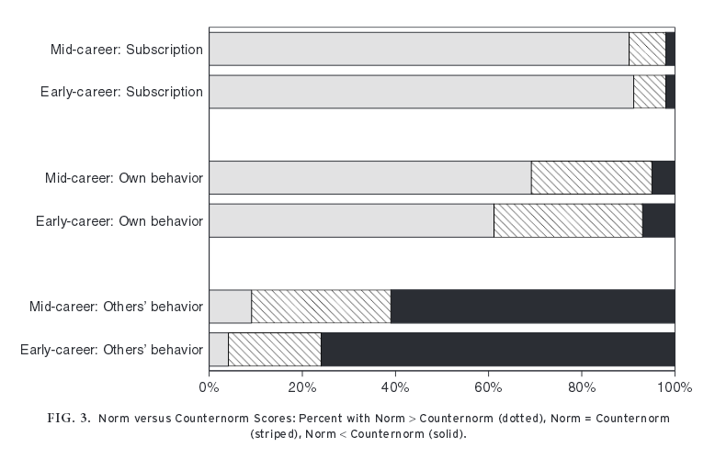
Researchers and Scientific Norms

Slide 6
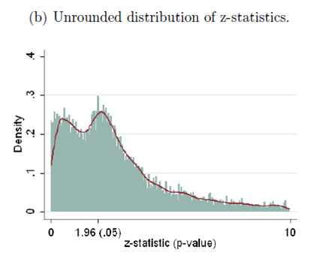
P-Hacking
Brodeur et. al.,(2016)

Slide 7
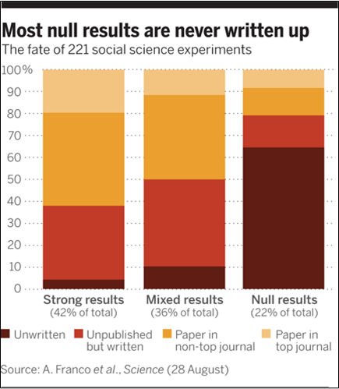
Publication Bias
Franco et. al., (2014)

Slide 8
Low Reproducibility
Replication in Social Sciences (Same method, different sample) | Reproduction in Economics (Same data and methods)
Open Science Collaboration (2015): 30% - 60% | Chang & Li (2015): 43%
Camerer (2016): ~60% | Gertler et. al., (2017): 14%
Nosek & Camerer et. al., (2018): ~60% | Kingi et. al., (2019): 43%
Klein et. al., (2018): 50% | Wood et. al., (2018): 25%

Slide 9
Outline
Introduction
BITSS: Past
BITSS: Present
BITSS: Future

Slide 10
What has BITSS done to address this issues?
Awareness on the problems and solutions: papers, manuals and convenings (RT2)
Learning: funded and conducted research on research; hosted pre-prints
Community building: Annual Meeting, Catalysts, blog

Slide 11
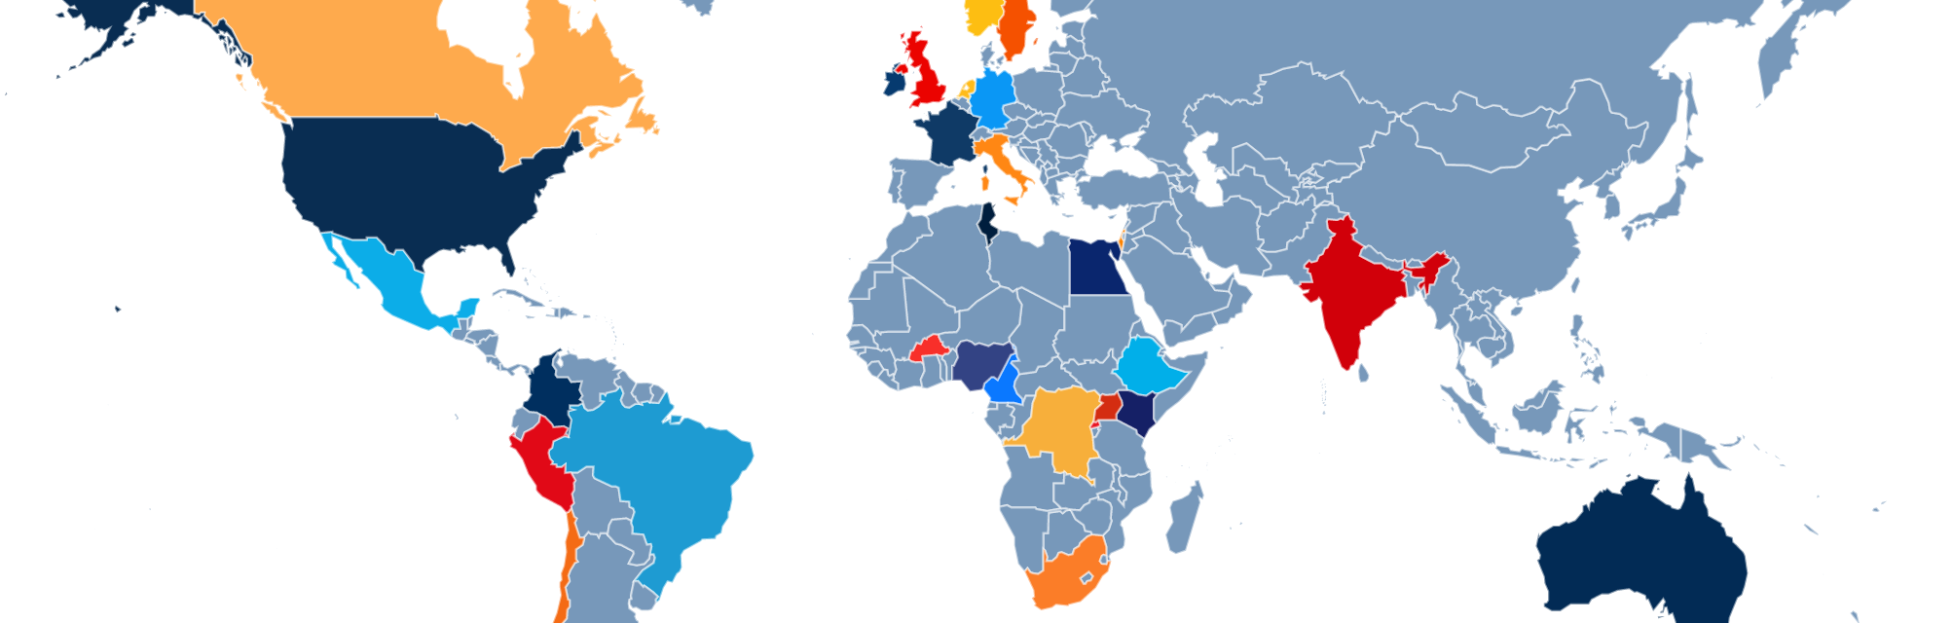
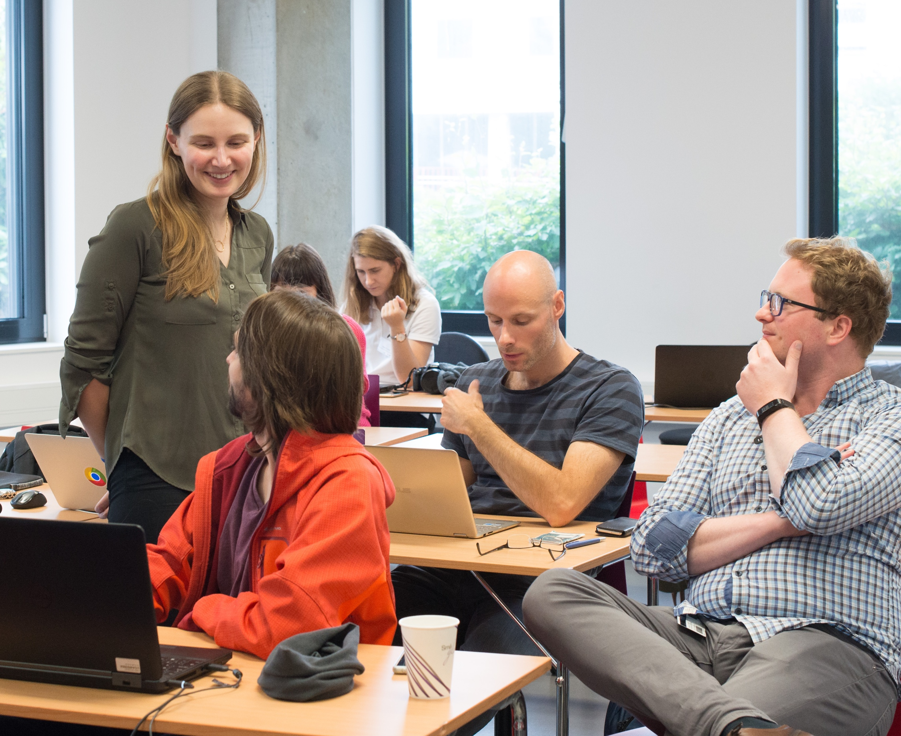
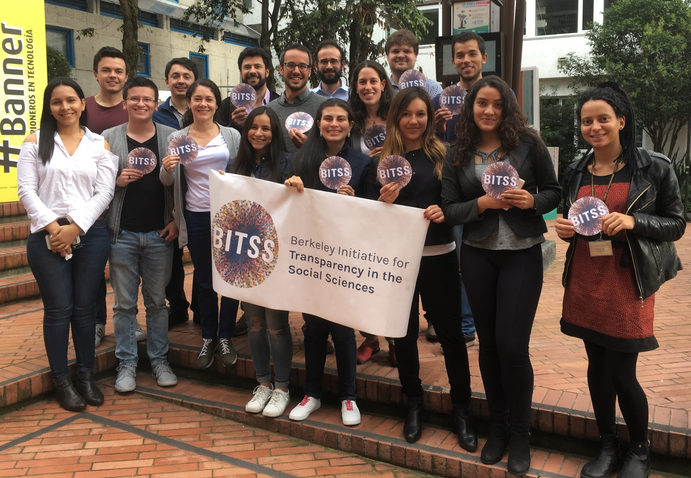
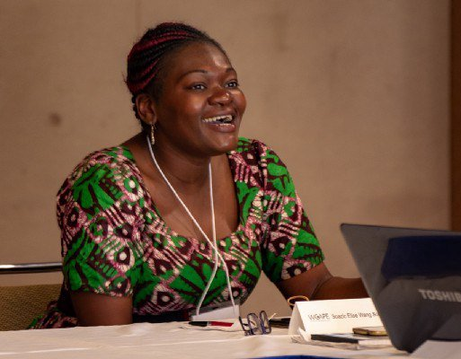
Our Network
BITSS Catalysts are PhD students, faculty, and researchers committed to advancing the teaching, practice, funding, and publishing of transparent and reproducible research.
120+ academics and practitioners;
90 institutions; 30 countries

Slide 12
Registrations
A registration is a record that contains minimal information about a study: title, authors, study country, status, keywords, abstract, start and end dates, outcomes, intervention information, basic research design, whether or not treatments are clustered (when performing an RCT), and Institutional Review Board (IRB) information.
Should be recorded before analyzing data
The main goal: track the complete body of knowledge in a topic of research, regardless of the direction and magnitude of the results.

Slide 13
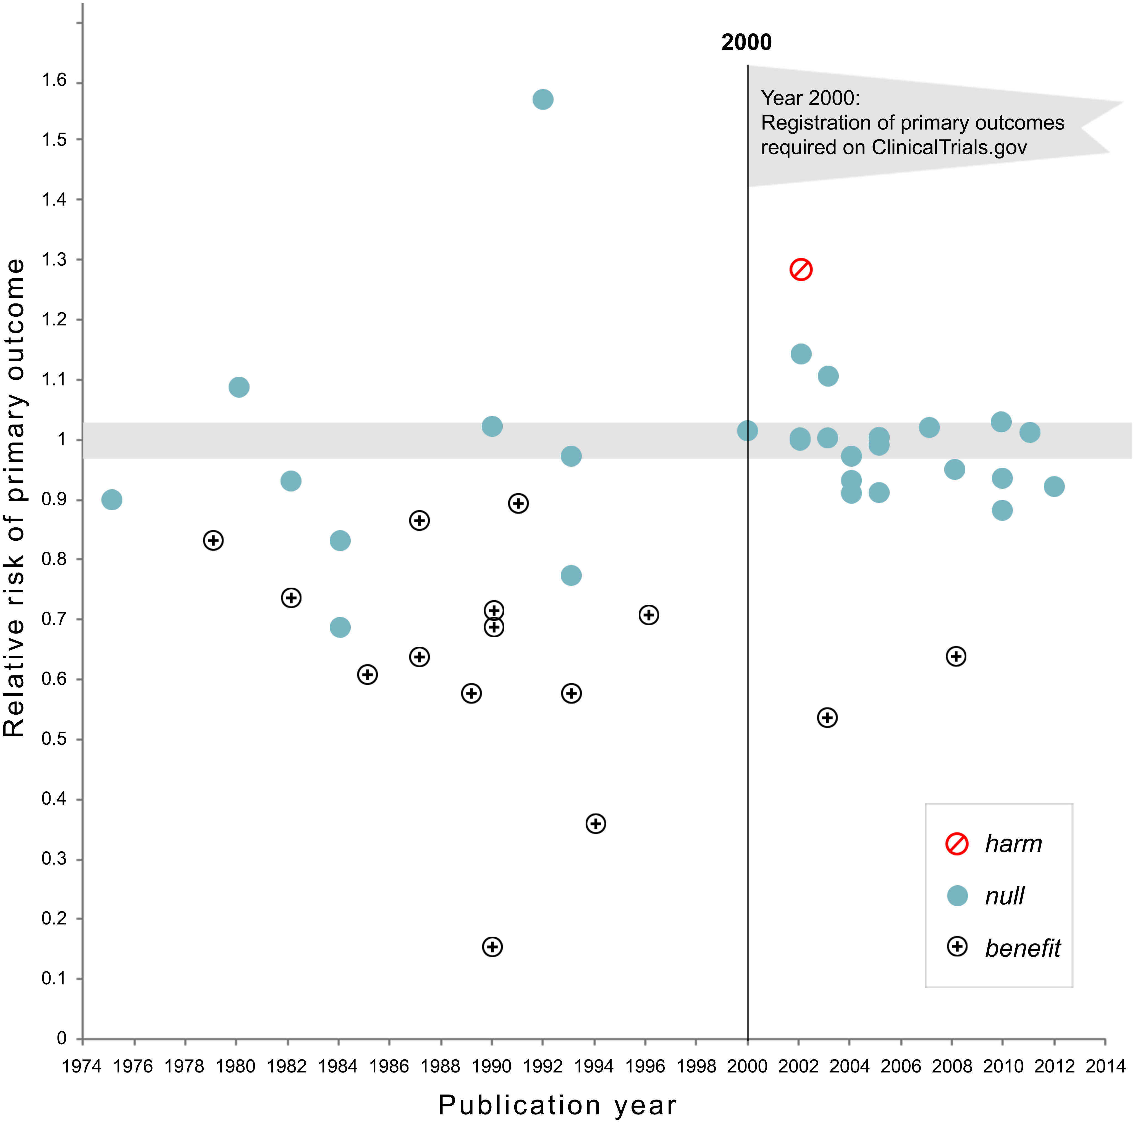
Why register: social planners perspective (Kaplan and Irvin, 2015)

Slide 14
Pre-Analysis Plans
PAPs are extensive methodological descriptions of the analysis to be performed before the endline data is collected
Helps to prevents p-hacking
Only way to guarantee accurate statistical testing
Distinguishes confirmatory from exploratory analysis

Slide 15
How To Do a Pre-Analysis Plan
Christensen, Freese and Miguel (Forthcoming) suggest detailed information on:
Detail study design
Sampling details
Outcome Measures
Index construction
Multiple hypothesis adjustments
Subgroup analysis
Direction of the effect (optional)
Exact statistical specification
Structural model (optional)
Timestamp

Slide 16
Common Concerns About PAPs
Critique | Response
PAPs take too much time and are too difficult (Olken 2015) | A PAP changes the timing of the analytic component, not clear that it increases it
Scientific discovery often comes from surprises. PAPs stifle discovery (Olken 2015) | PAPs do not prevent researchers from doing exploratory work; they only require researchers to be clear about the objectives of their analyses.
If replications are cheap they will rule out false positives, making PAPs irrelevant. (Coffman and Niederle 2015) | Very few experiments are inexpensive as to perform many replications. Moreover, most of the false positives have been identified where experiments are least expensive (lab experiments).

Slide 17
Outline
Introduction
BITSS: Past
BITSS: Present
BITSS: Future

Slide 18
What is BITSS doing today?
Changing norms: RR at the JDE, best practices at the IDB and INSP
Learning: More meta-research: 3S, Citations study
Community building: AM, Catalysts, RT2

Slide 19

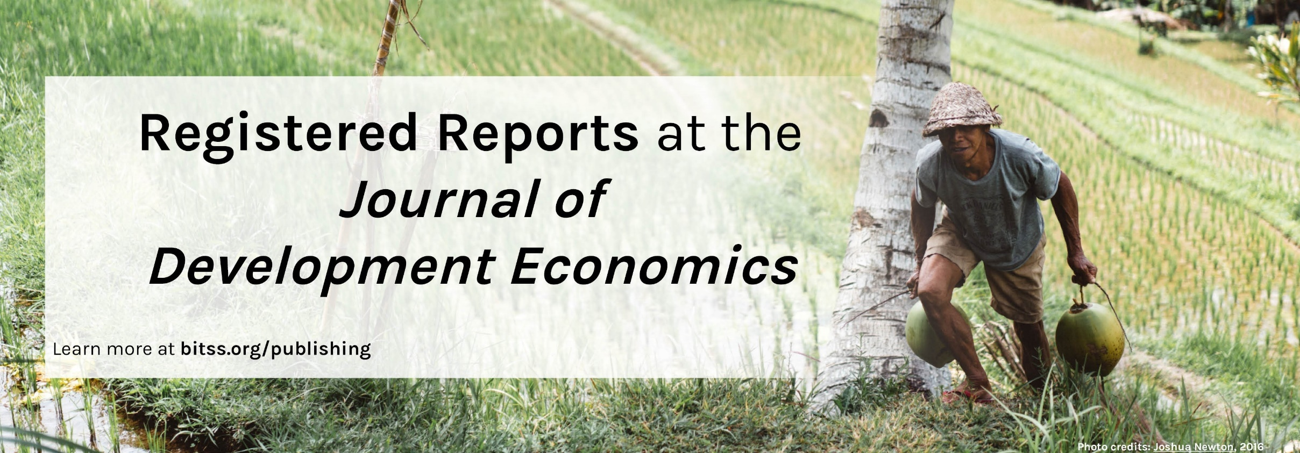

Slide 20
Registered Reports
Registered Reports are empirical research articles that are peer-reviewed and accepted for publication before the results are known.
Peer review & decision to publish
Confirmation of decision to publish
Develop research design & analysis plan
Collect & analyze data
Write up paper
Publish paper

Slide 21
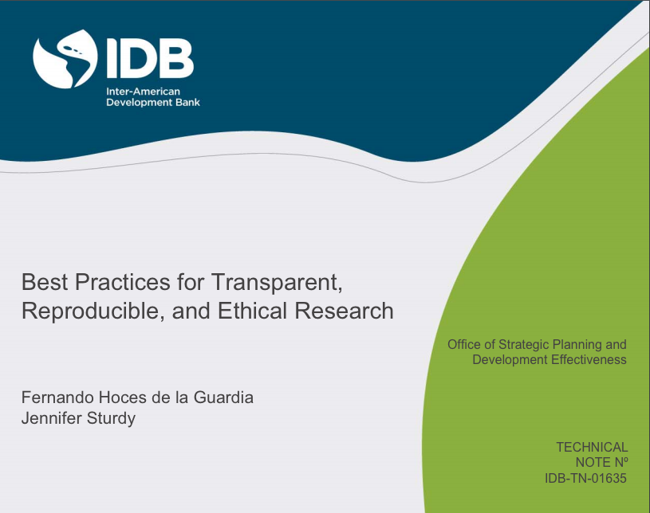
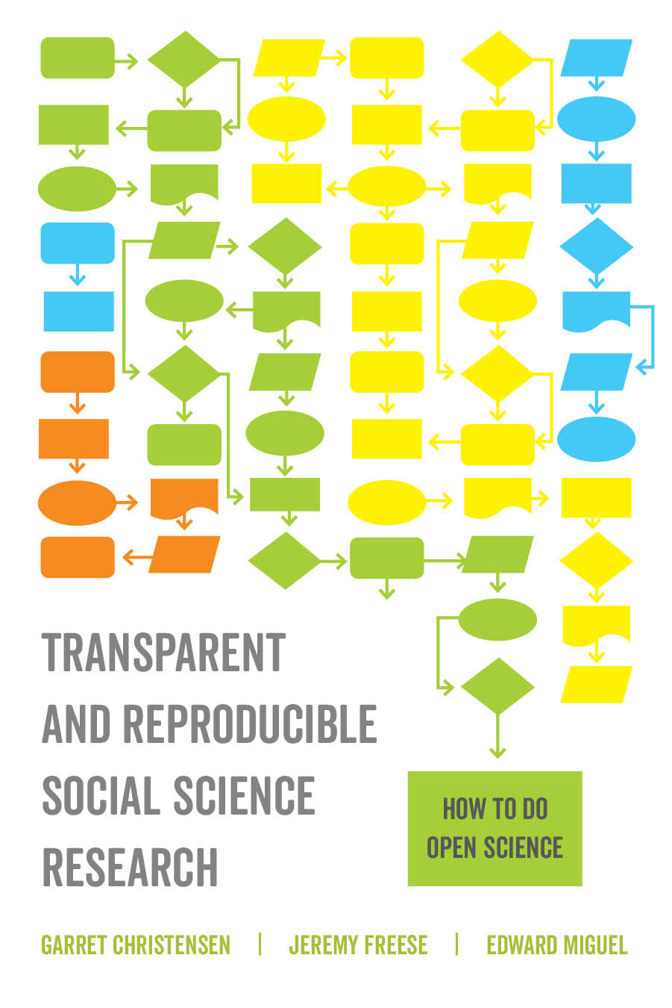
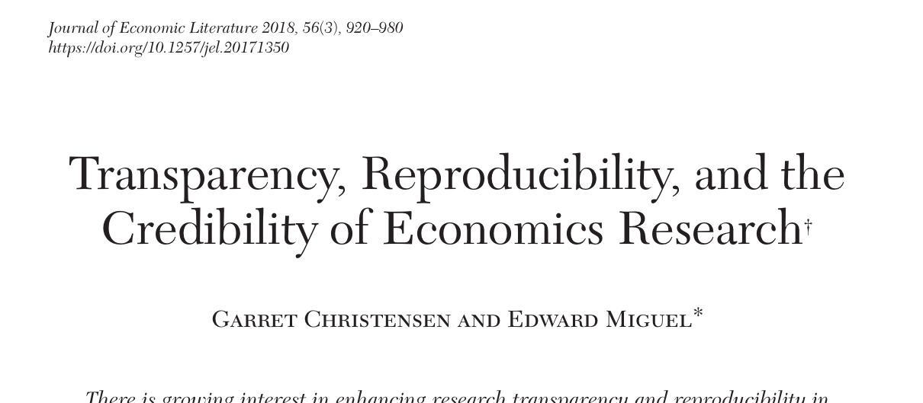
Recent Publications

Slide 22
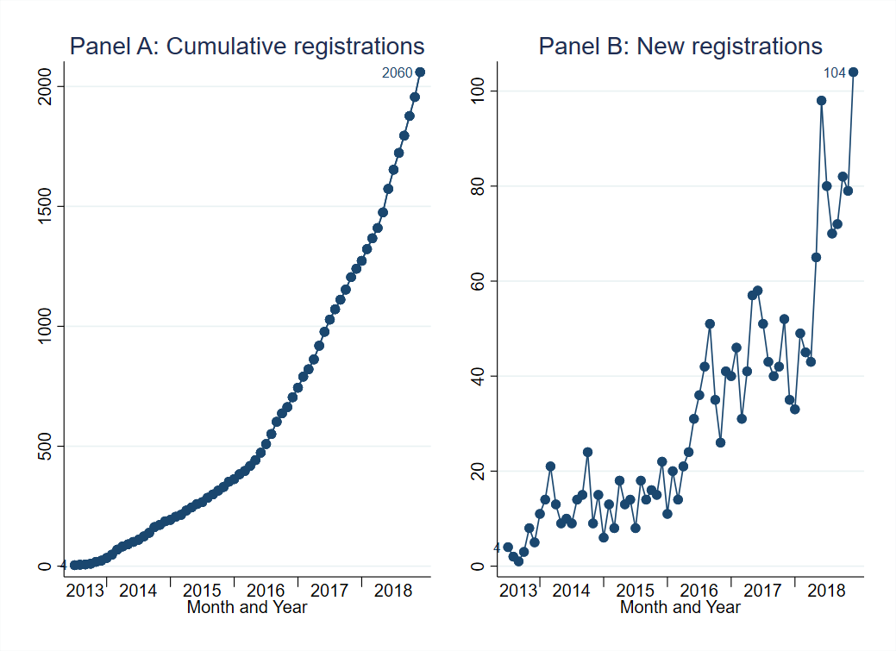
Change is happening
Record number of registrations on the AEA RCT Registry in 2018!

Slide 23
Outline
Introduction
BITSS: Past
BITSS: Present
BITSS: Future

Slide 24
What is in the horizon for BITSS?
Community building: AM, Catalysts, RT2
Computational reproducibility: in the classroom and in papers
Super Forecasters in Social Sciences
Open Policy Analysis

Slide 25
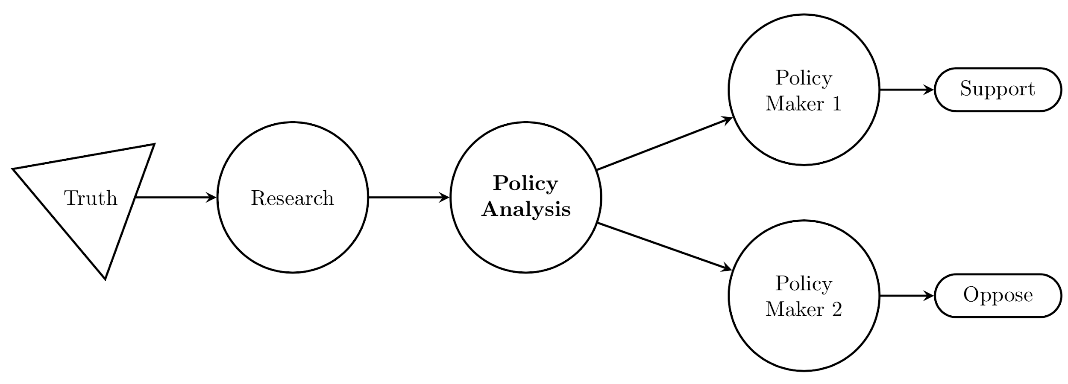
Why Bring Open Science into Policy Analysis?
Notes:
You are all here to add RT to research, but when it comes to PA… Test adding example of minimum wage.

Slide 26
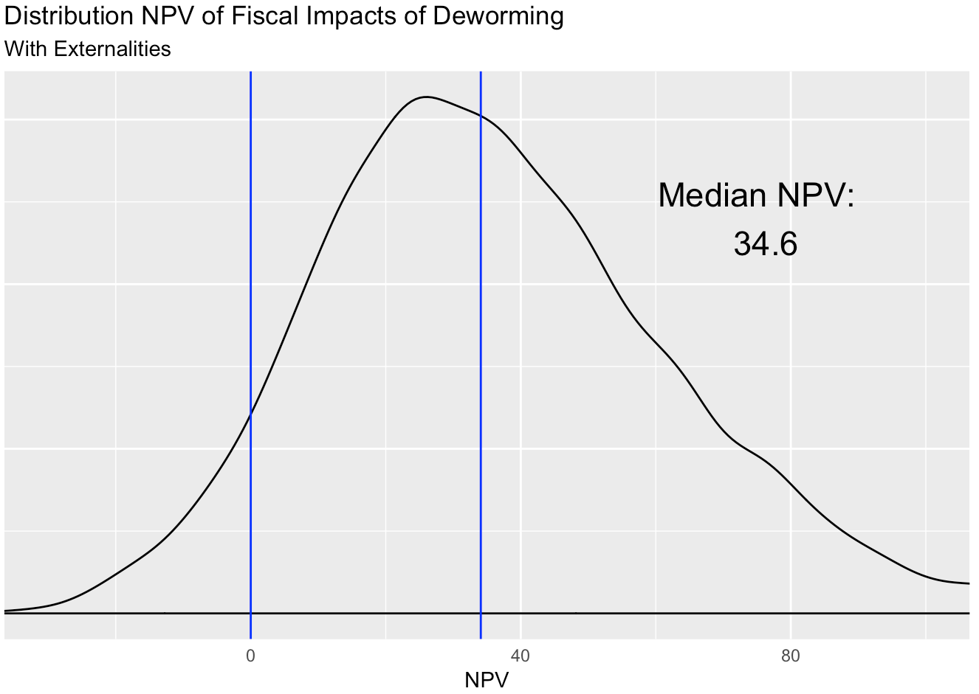
One clear output for policy makers
Notes:
For example this graph is the culmination of lots of work, but tells you a very simple and important story

Slide 27
Clear input-output
link
Notes:
Comment that this tools are now available to analysts with minimal programming skills.

Slide 28
Complete dynamic documentation
Notes:
This tools are already out there and we just need people to train

Slide 29
Complete reproducible repository

Slide 30
Our Framework for Open Policy Analysis
- Unified output
- Clear output-input link
Open Output
Open Analysis
Open Materials
Policy Makers
Output
Staffers/Advisors
Assumptions
- Open Code
- Open Data (raw & final)
- Open Report
Policy Analysts & Researchers
All details
Policy Analysts & Researchers
All materials
- Common file structure
- Label data, research, guesswork
- Make code/spreadsheets reproducible
- Use a version control

Slide 31
Our Plan for OPA
Develop framework to support OPA
Support transition/adoption of OPA, and develop case studies
Train students and analysts
Raise awareness
Notes:
Develop framework to support OPA
Principles
Guidelines
Support transition/adoption to OPA, and develop case studies
Minimum wage in the US
Deworming in Kenya
Train students and analysts
RT2-type of curriculum (policy/economics)
Raise awareness
This panel
Future convenings
Ongoing presentations (so far APPAM, Evidence Action, GSPP, EDI, GiveWell, AIR, CBO, IDB, AM1)

Slide 32
Want to be part of BITSS?
Join or mailing list
Work with us as an intern
Become a scientist and change the field (join as a catalyst)
For more info check out bitss.org and follow us on twitter at @UCBITSS

Slide 33
Other Open Science Initiatives
Center for Open Science (COS)
Berkeley Institute for Data Science (BIDS)
Data Stewardship programs
Project TIER (Teaching Integrity in Empirical Research)
EQUATOR Network
SPARC Open (Open Con)
Meta-Research Innovation Center at Stanford (METRICS)
Research Transparency Teams at J-PAL, IPA, 3ie
SIPS (Society for the Improvement of Psychological Science)
Mozilla Science Lab
The Engine Room – responsible data in development

